Slide 1
Supervised vs. Unsupervised Learning
Supervised learning (classification)
Supervision: The training data (observations, measurements, etc.) are accompanied by labels indicating the class of the observations
New data is classified based on the training set
Unsupervised learning (clustering)
The class labels of training data is unknown
Given a set of measurements, observations, etc. with the aim of establishing the existence of classes or clusters in the data
‹#›
Notes:
‹#›

Slide 2
Decision Tree
Flowchart like tree structure
Internal non leaf node denotes test on an attribute
Branch represents outcome of the test
Leaf node holds a class label
The topmost node of the tree is the root node

Slide 3
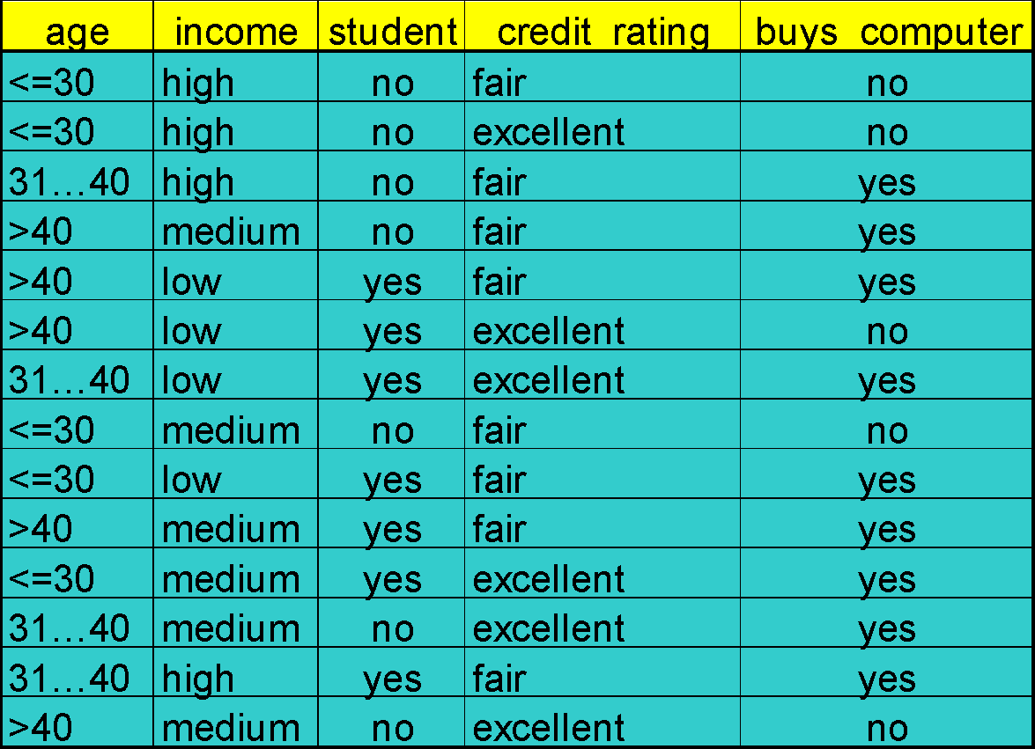
Decision Tree Induction: Training Dataset
This follows an example of Quinlan’s ID3 (Playing Tennis)
‹#›

Slide 4
Output: A Decision Tree for “buys_computer”
age?
<=30
overcast
>40
31..40
student?
yes
credit rating?
no
yes
excellent
fair
no
yes
no
yes
‹#›

Slide 5
Why Decision Tree Classifier is so popular
Does not require Domain Knowledge or parameter settings
Supports exploratory knowledge discovery
Decision trees can handle high dimensional data
Decision tree knowledge is intuitive and easily understandable by humans
Learning and classification steps are simple and fast
Decision trees have good accuracy

Slide 6
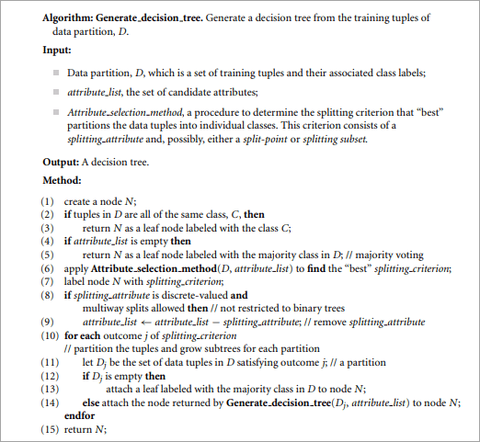

Slide 7
Explanation(Algorithm)
The algorithm is called with three parameters: D, attribute list, and Attribute selection method.
Let D as a data partition. Initially, it is the complete set of training tuples and their associated class labels.
The parameter attribute list is a list of attributes describing the tuples.
Attribute selection method specifies a heuristic procedure for selecting the attribute that “best” discriminates the given tuples according to class.
‹#›

Slide 8
Attribute selection measure can be
information gain, do not, therein allowing multiway splits (i.e., two or more branches to be grown from a node).
gain ratio
gini index, enforce the resulting tree to be binary.
‹#›

Slide 9
The tree starts as a single node, N, representing the training tuples in D (step 1).
If the tuples in D are all of the same class, then node N becomes a leaf and is labeled with that class (steps 2 and 3).
steps 4 and 5 are terminating conditions.
Otherwise, the algorithm calls Attribute selection method to determine the splitting criterion.
All of the tuples in the partition D belong to the same class(2,3)
No remaining attributes on which the tuples can be further partitioned(4,5)
No tuples for a given branch(12,13)
‹#›

Slide 10
The splitting criterion tells us which attribute to test at node N by determining the “best” way to separate or partition the tuples in D into individual classes (step 6).
The splitting criterion is determined so that, ideally, the resulting partitions at each branch are as “pure” as possible.
all of the tuples in it belong to the same class
The node N is labeled with the splitting criterion, which serves as a test at the node (step 7).
‹#›

Slide 11
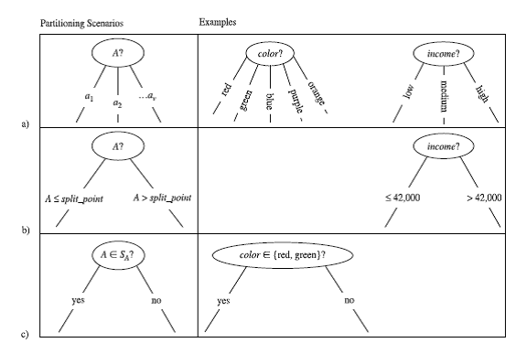
A branch is grown from node N for each of the outcomes of the splitting criterion. The tuples in D are partitioned accordingly (steps 10 to 11).
There are three possible scenarios,

Slide 12
at each resulting partition, Dj, of D (step 14).
Because all of the tuples in a given partition have the same value for A, then A need not be considered in any future partitioning of the tuples. Therefore, it is removed from attribute list (steps 8 to 9).
The algorithm uses the same process recursively to form a decision tree for the tuples at each resulting partition, Dj , of D (step 14)
‹#›

Slide 13
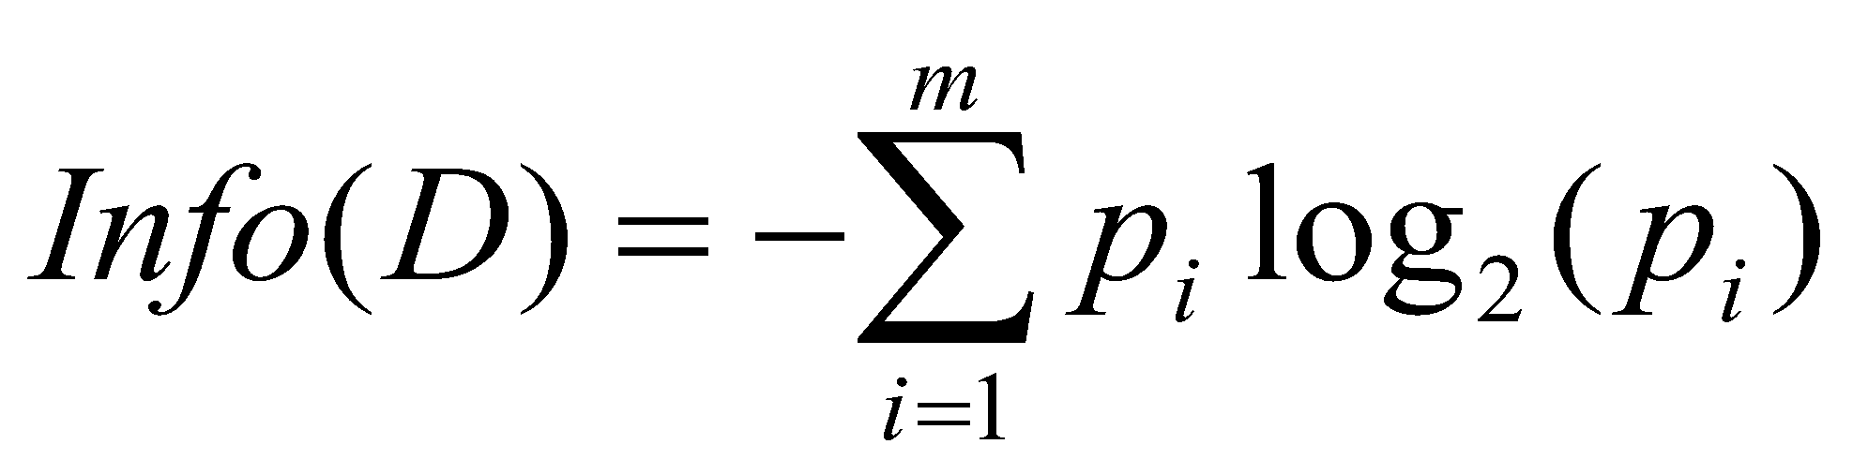
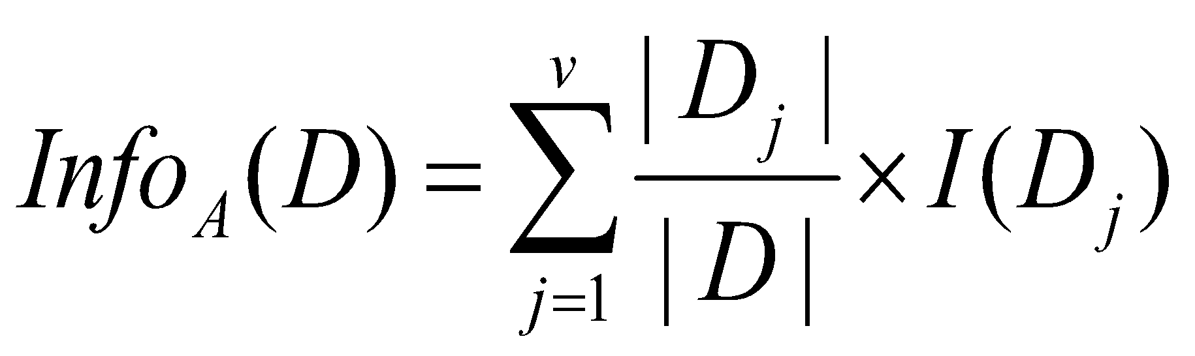
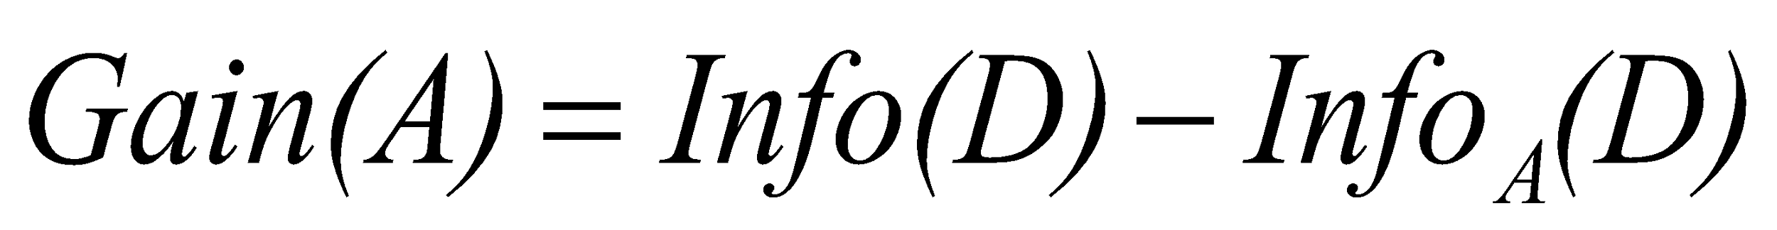
Attribute Selection Measure: Information Gain (ID3/C4.5)
Select the attribute with the highest information gain
Let p_{i} be the probability that an arbitrary tuple in D belongs to class C_{i}, estimated by |C_{i, D}|/|D|
Expected information (entropy) needed to classify a tuple in D:
Information needed (after using A to split D into v partitions) to classify D:
Information gained by branching on attribute A
‹#›
Notes:
‹#›
I : the expected information needed to classify a given sample
E (entropy) : expected information based on the partitioning into subsets by A

Slide 14
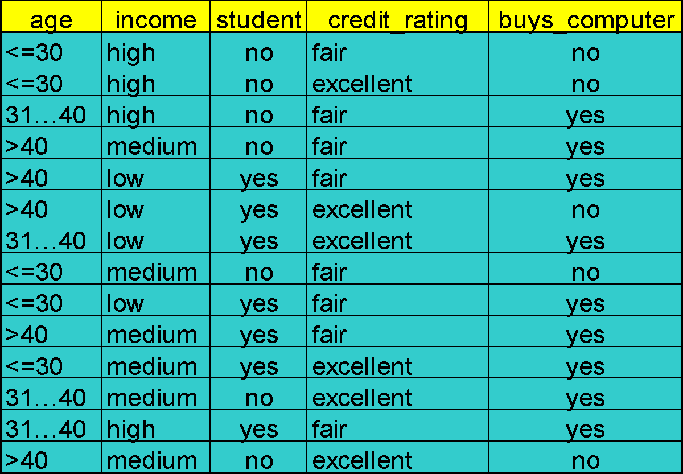
‹#›

Slide 15
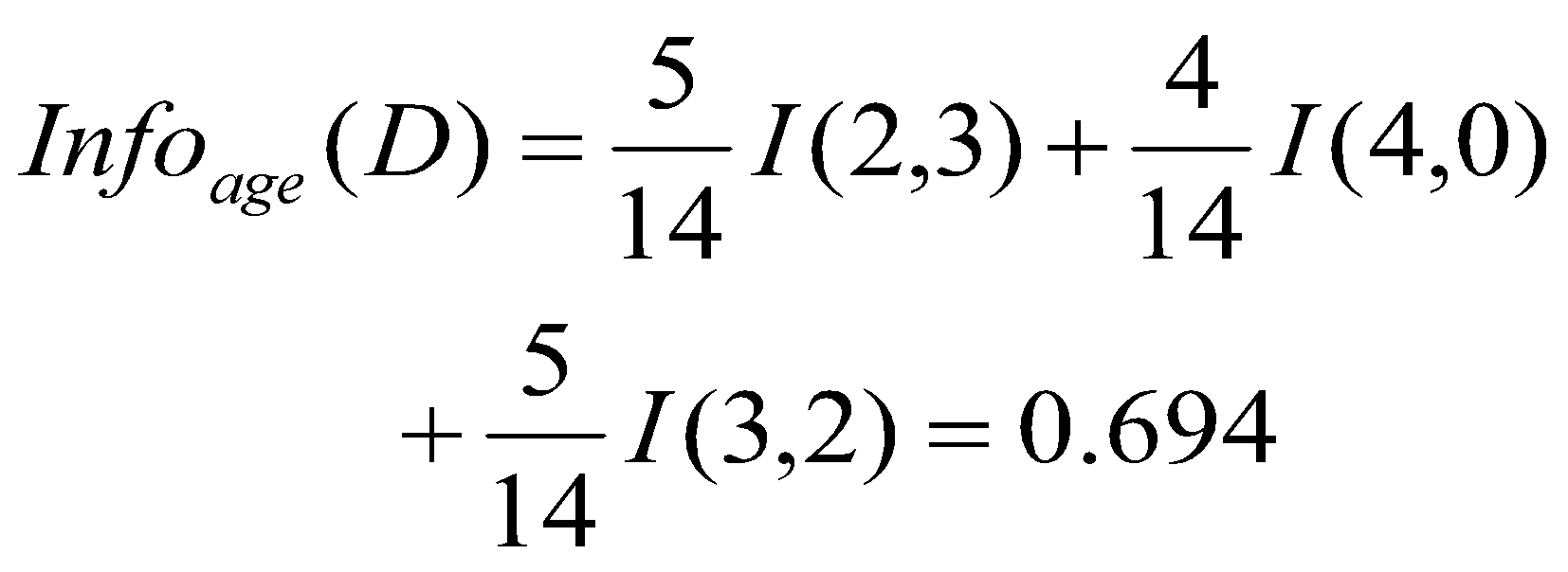
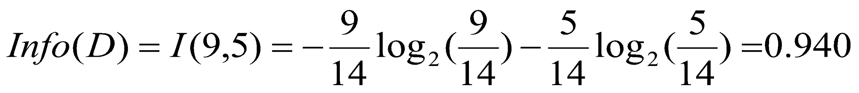
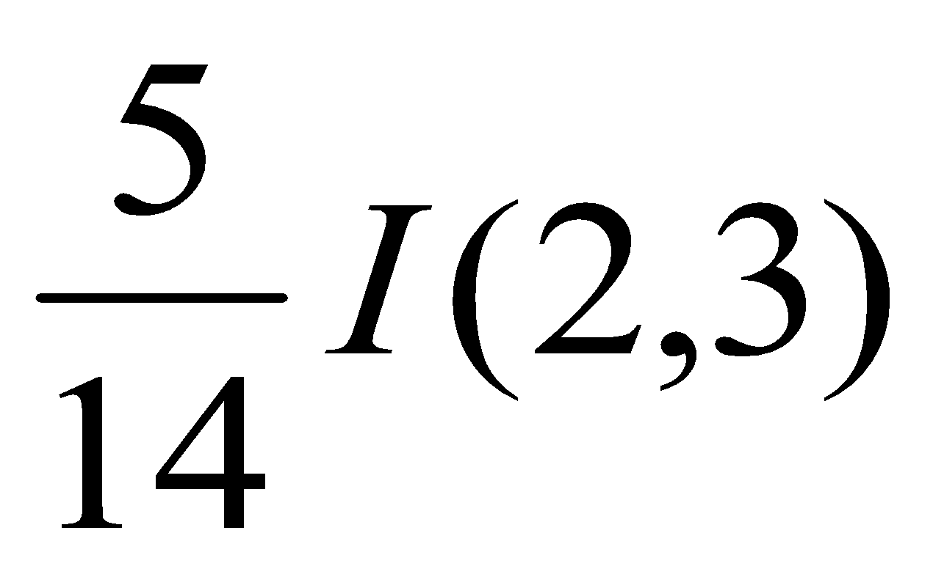
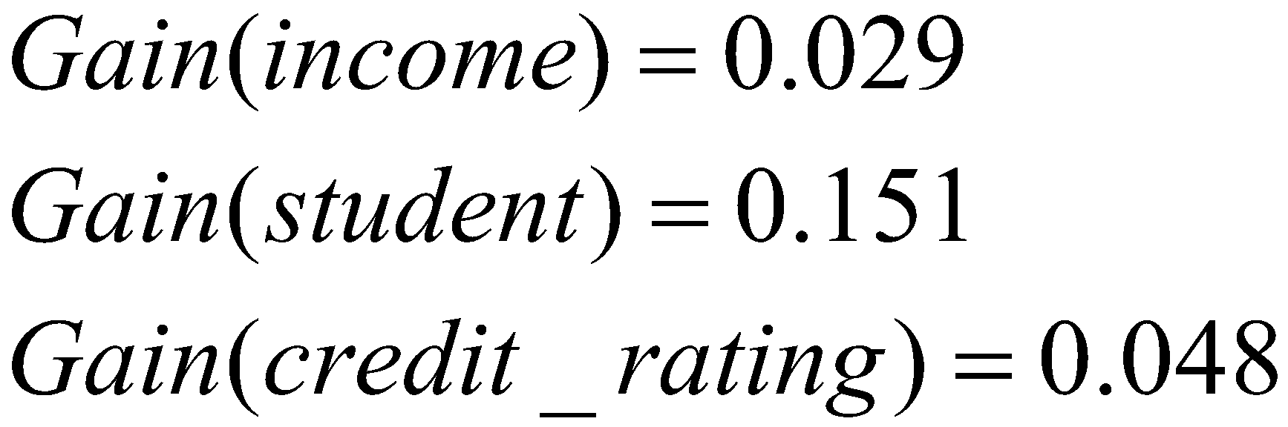
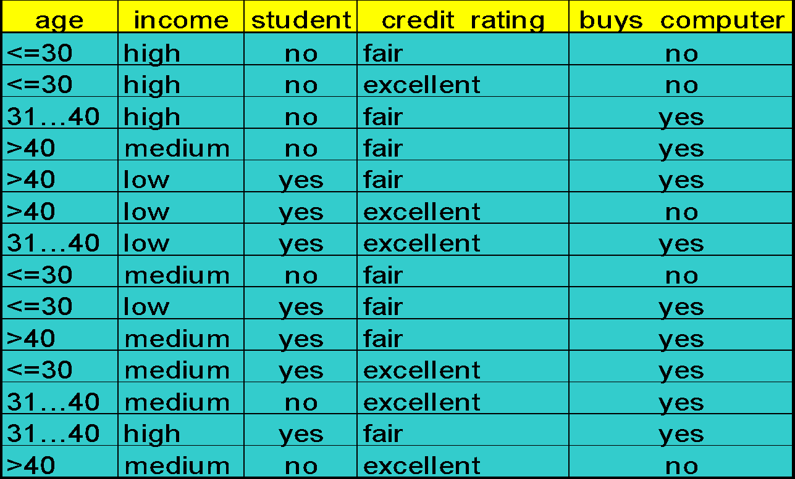
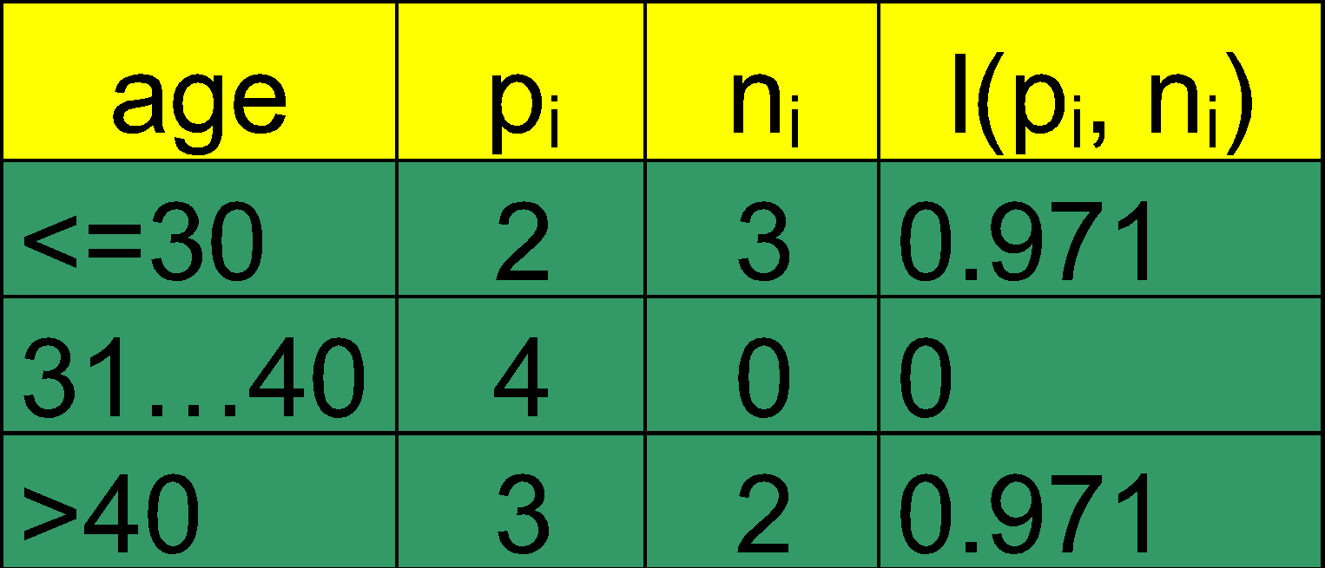
Attribute Selection: Information Gain
Class P: buys_computer = “yes”
Class N: buys_computer = “no”
means “age <=30” has 5 out of 14 samples, with 2 yes’es and 3 no’s. Hence
Similarly,
‹#›

Slide 16
Computing Information-Gain for Continuous-Value Attributes
Let attribute A be a continuous-valued attribute
Must determine the best split point for A
Sort the value A in increasing order
Typically, the midpoint between each pair of adjacent values is considered as a possible split point
(a_{i}+a_{i+1})/2 is the midpoint between the values of a_{i} and a_{i+1}
The point with the minimum expected information requirement for A is selected as the split-point for A
Split:
D1 is the set of tuples in D satisfying A ≤ split-point, and D2 is the set of tuples in D satisfying A > split-point
‹#›

Slide 17
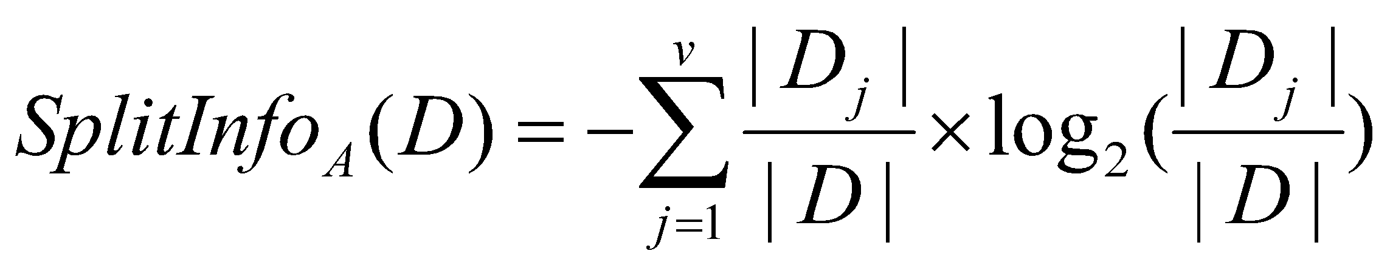
Gain Ratio for Attribute Selection (C4.5)
Information gain measure is biased towards attributes with a large number of values
C4.5 (a successor of ID3) uses gain ratio to overcome the problem (normalization to information gain)
GainRatio(A) = Gain(A)/SplitInfo(A)
Ex.
gain_ratio(income) = 0.029/0.926 = 0.031
The attribute with the maximum gain ratio is selected as the splitting attribute
‹#›

Slide 18
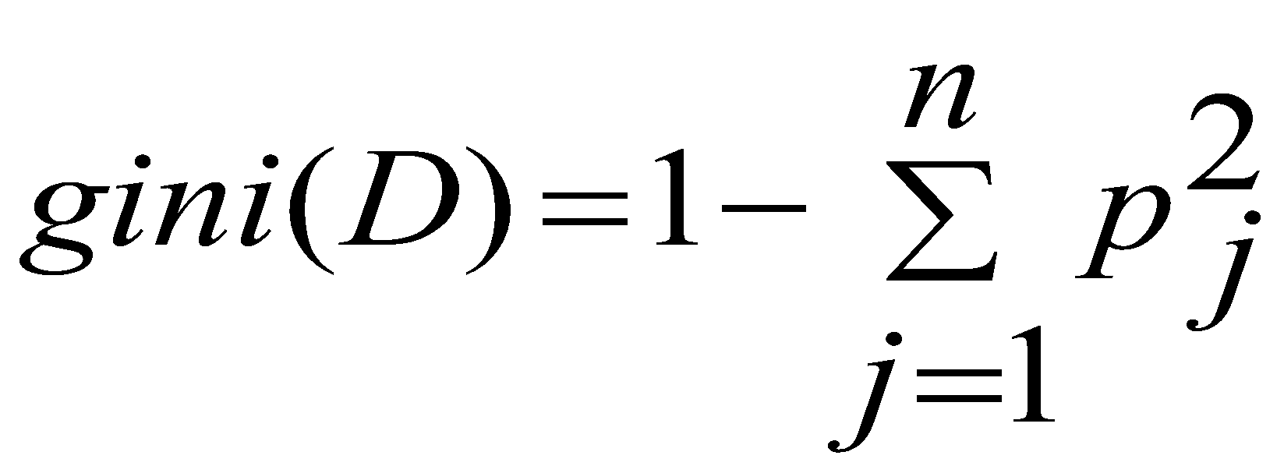
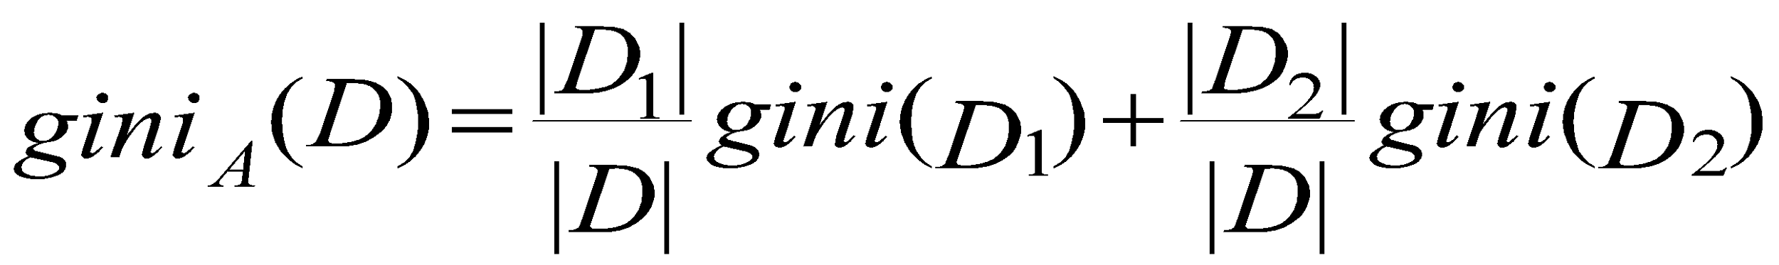
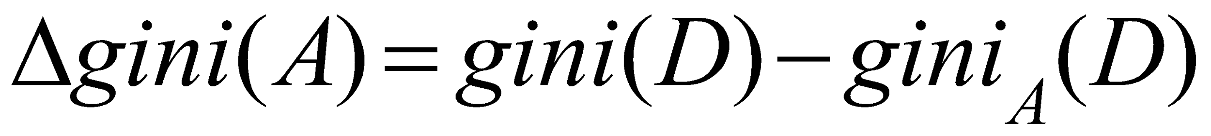
Gini index (CART, IBM IntelligentMiner)
If a data set D contains examples from n classes, gini index, gini(D) is defined as
where p_{j} is the relative frequency of class j in D
If a data set D is split on A into two subsets D₁ and D₂, the gini index gini(D) is defined as
Reduction in Impurity:
The attribute provides the smallest gini_{split}(D) (or the largest reduction in impurity) is chosen to split the node (need to enumerate all the possible splitting points for each attribute)
‹#›

Slide 19
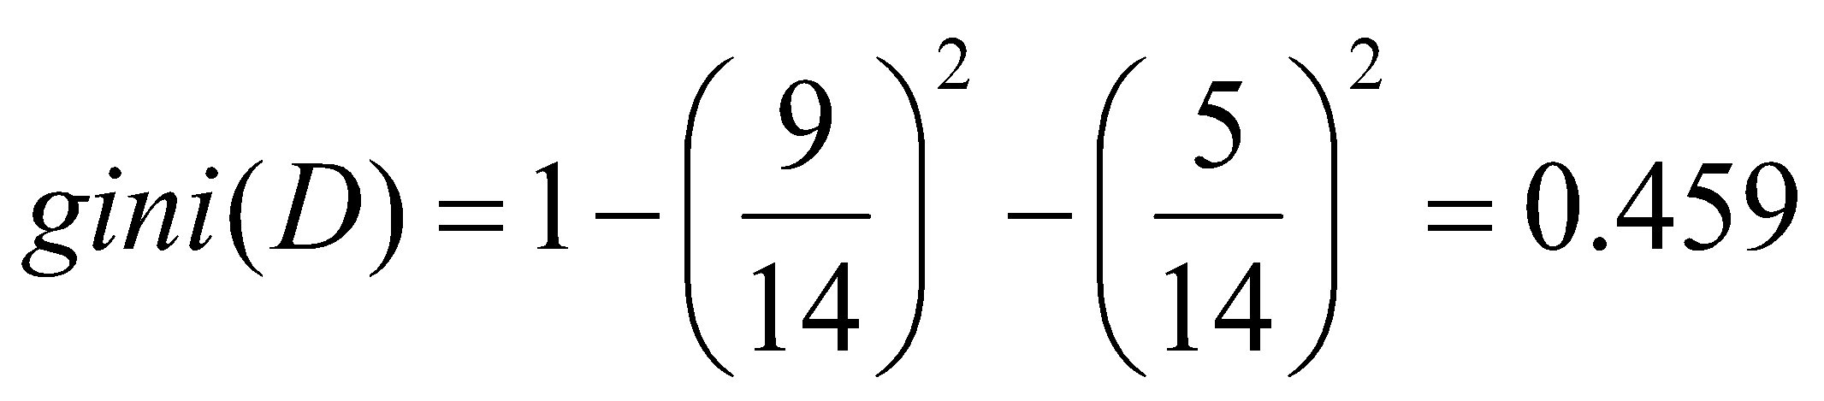
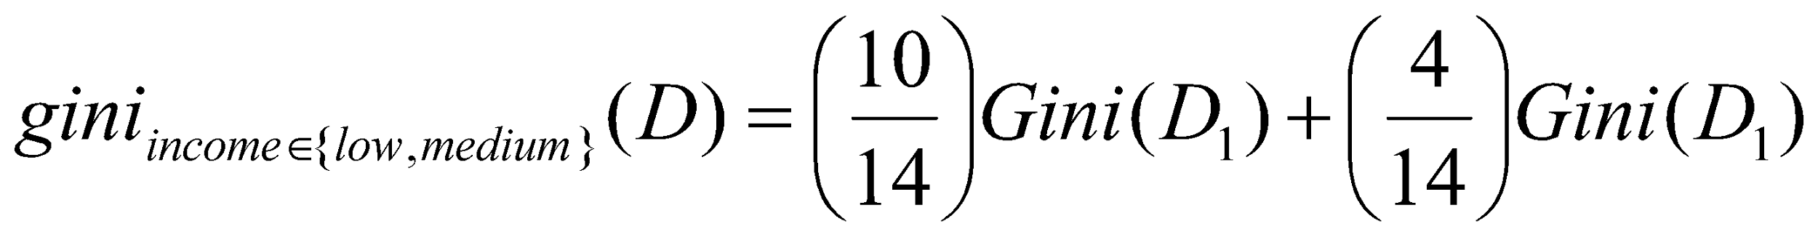
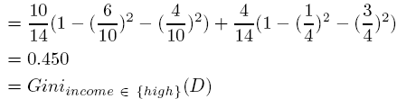
Gini index (CART, IBM IntelligentMiner)
Ex. D has 9 tuples in buys_computer = “yes” and 5 in “no”
Suppose the attribute income partitions D into 10 in D₁: {low, medium} and 4 in D₂
but gini_{{medium,high}} is 0.30 and thus the best since it is the lowest
All attributes are assumed continuous-valued
May need other tools, e.g., clustering, to get the possible split values
Can be modified for categorical attributes
‹#›

Slide 20
Comparing Attribute Selection Measures
The three measures, in general, return good results but
Information gain:
biased towards multivalued attributes
Gain ratio:
tends to prefer unbalanced splits in which one partition is much smaller than the others
Gini index:
biased to multivalued attributes
has difficulty when # of classes is large
tends to favor tests that result in equal-sized partitions and purity in both partitions
‹#›
Notes:
‹#›

Slide 21
Other Attribute Selection Measures
CHAID: a popular decision tree algorithm, measure based on χ² test for independence
C-SEP: performs better than info. gain and gini index in certain cases
G-statistic: has a close approximation to χ² distribution
MDL (Minimal Description Length) principle (i.e., the simplest solution is preferred):
The best tree as the one that requires the fewest # of bits to both (1) encode the tree, and (2) encode the exceptions to the tree
Multivariate splits (partition based on multiple variable combinations)
CART: finds multivariate splits based on a linear comb. of attrs.
Which attribute selection measure is the best?
Most give good results, none is significantly superior than others
‹#›
Notes:
‹#›

Slide 22
Overfitting and Tree Pruning
Overfitting: An induced tree may overfit the training data
Too many branches, some may reflect anomalies due to noise or outliers
Poor accuracy for unseen samples
Two approaches to avoid overfitting
Prepruning: Halt tree construction early ̵ do not split a node if this would result in the goodness measure falling below a threshold
Difficult to choose an appropriate threshold
Postpruning: Remove branches from a “fully grown” tree—get a sequence of progressively pruned trees
Use a set of data different from the training data to decide which is the “best pruned tree”
‹#›
Notes:
‹#›

Slide 23
Enhancements to Basic Decision Tree Induction
Allow for continuous-valued attributes
Dynamically define new discrete-valued attributes that partition the continuous attribute value into a discrete set of intervals
Handle missing attribute values
Assign the most common value of the attribute
Assign probability to each of the possible values
Attribute construction
Create new attributes based on existing ones that are sparsely represented
This reduces fragmentation, repetition, and replication
‹#›
Notes:
‹#›

Slide 24
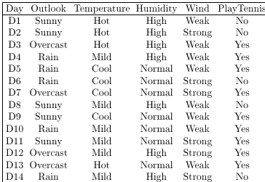
DECISION TREES
Which Attribute is the Best Classifier?: Information Gain
Let’s investigate the attribute Wind
‹#›
Notes:
‹#›

Slide 25
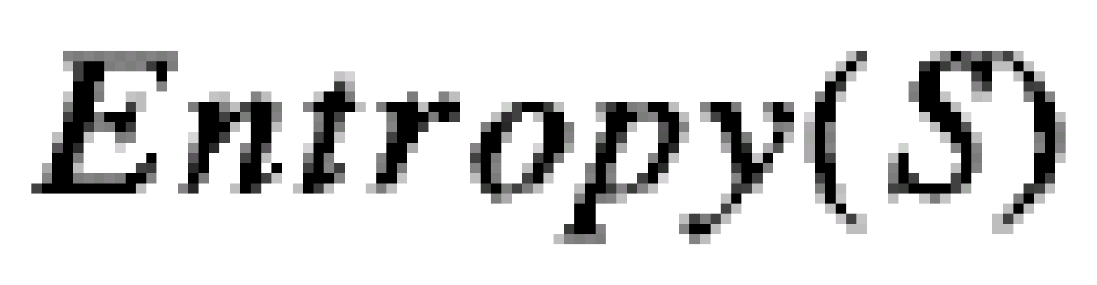
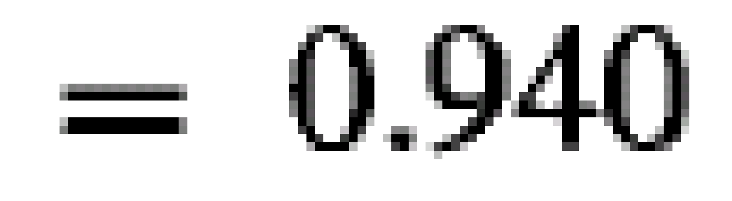
DECISION TREES
Which Attribute is the Best Classifier?: Information Gain
The collection of examples has 9 positive values and 5 negative ones
Eight (6 positive and 2 negative ones) of these examples have the attribute value Wind = Weak
Six (3 positive and 3 negative ones) of these examples have the attribute value Wind = Strong
‹#›
Notes:
‹#›

Slide 26
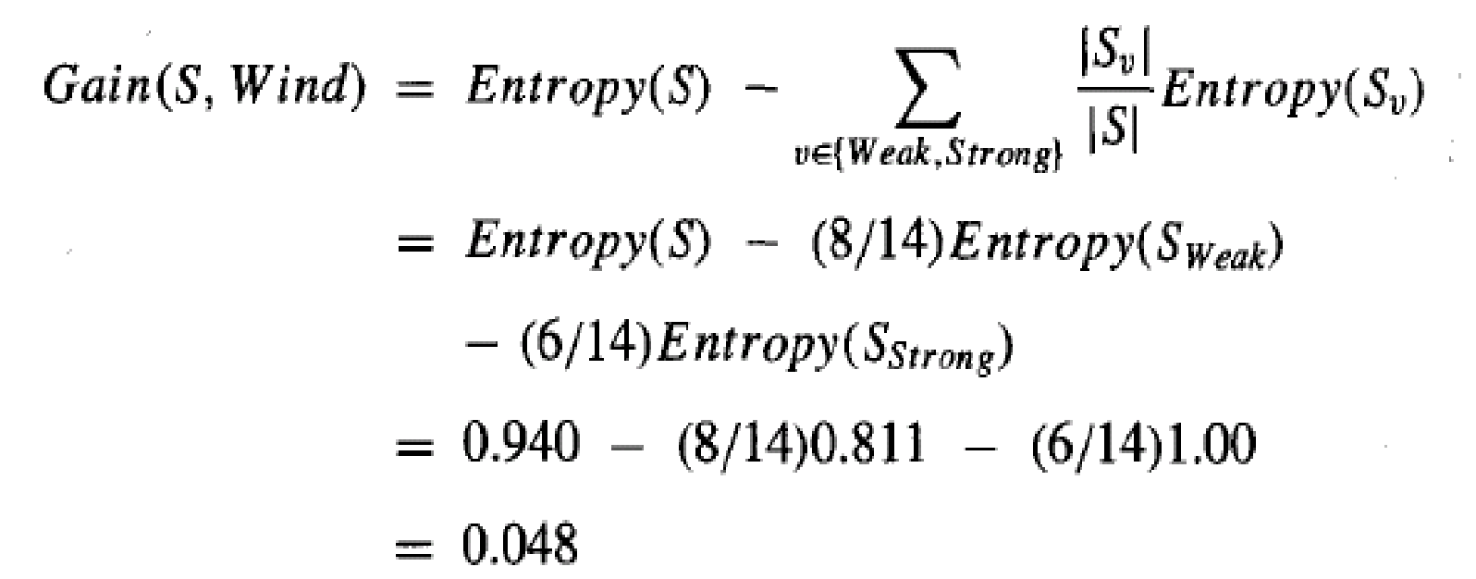
DECISION TREES
Which Attribute is the Best Classifier?: Information Gain
The information gain obtained by separating the examples according to the attribute Wind is calculated as:
‹#›
Notes:
‹#›

Slide 27
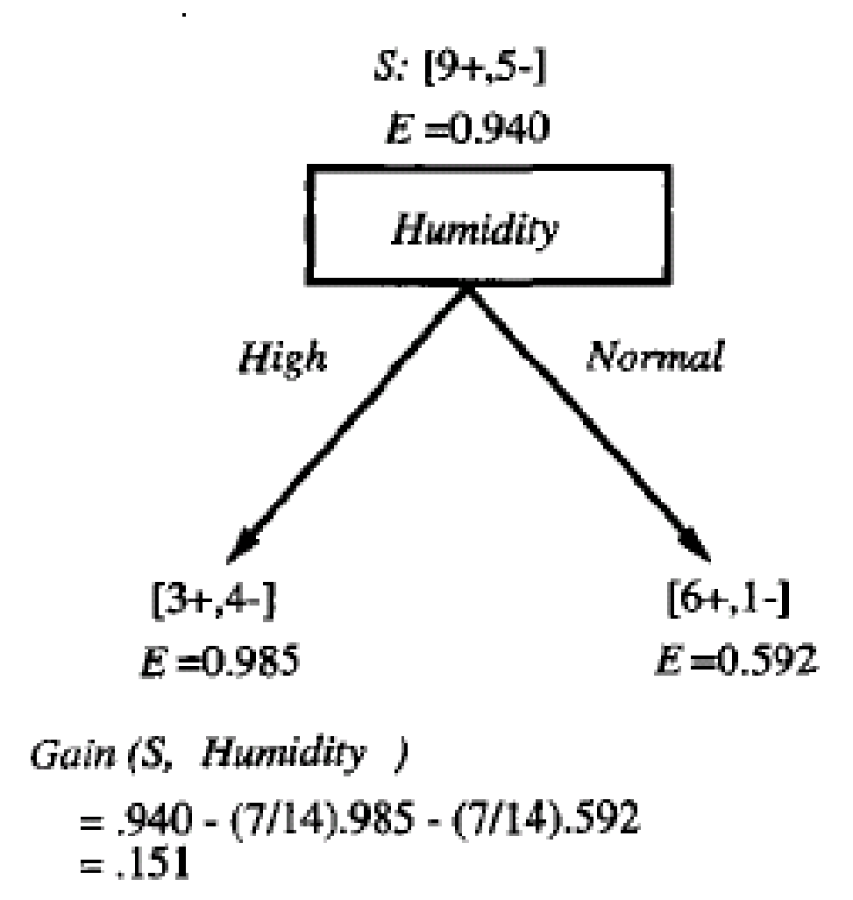
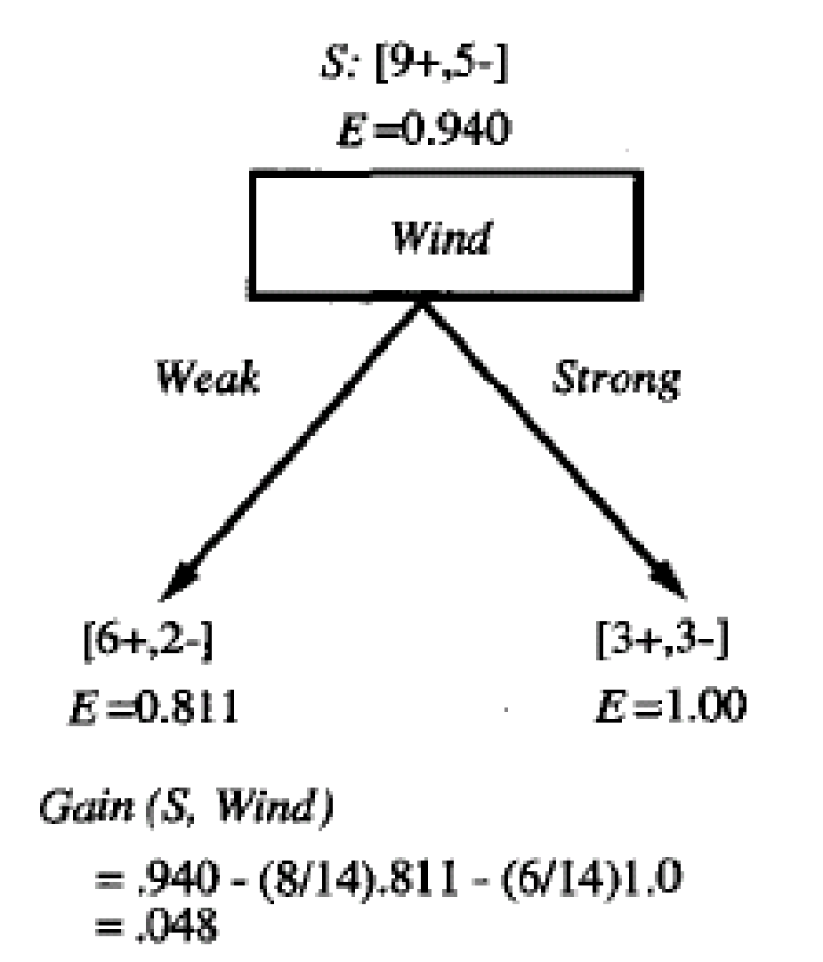
DECISION TREES
Which Attribute is the Best Classifier?: Information Gain
We calculate the Info Gain for each attribute and select the attribute having the highest Info Gain
‹#›
Notes:
‹#›

Slide 28
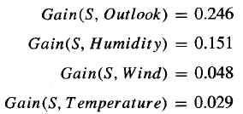
DECISION TREES
Example
Which attribute should be selected as the first test?
“Outlook” provides the most information
‹#›
Notes:
‹#›

Slide 29
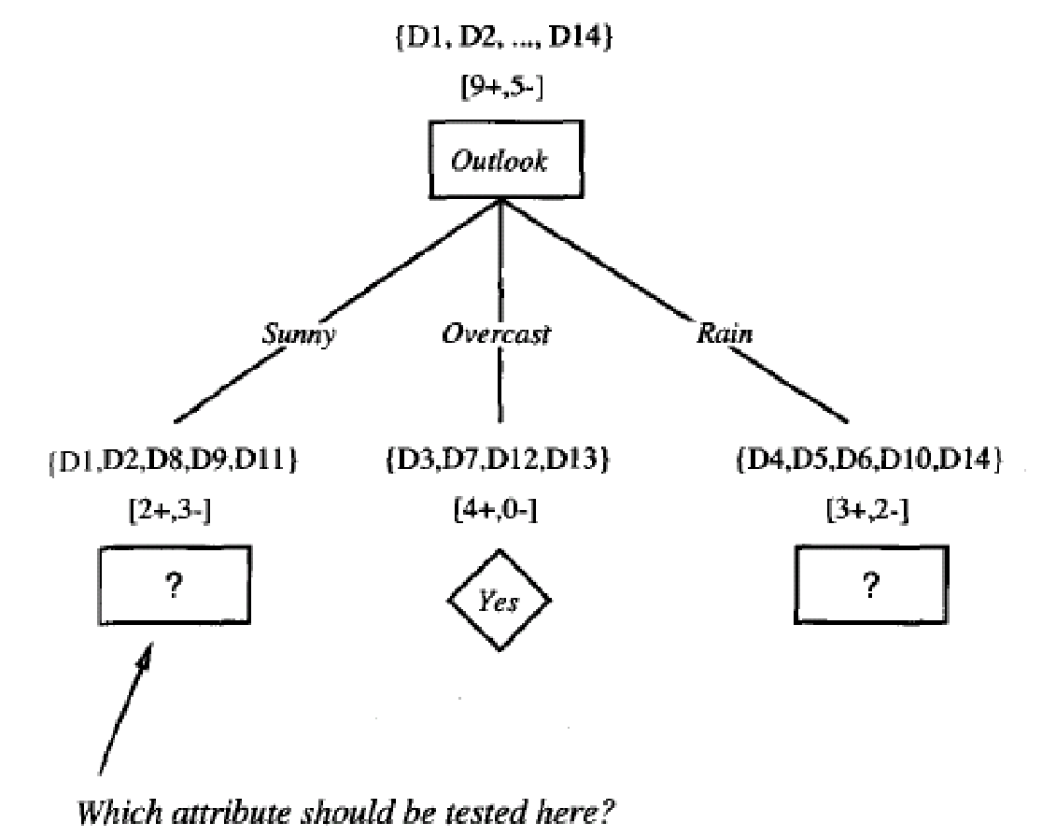
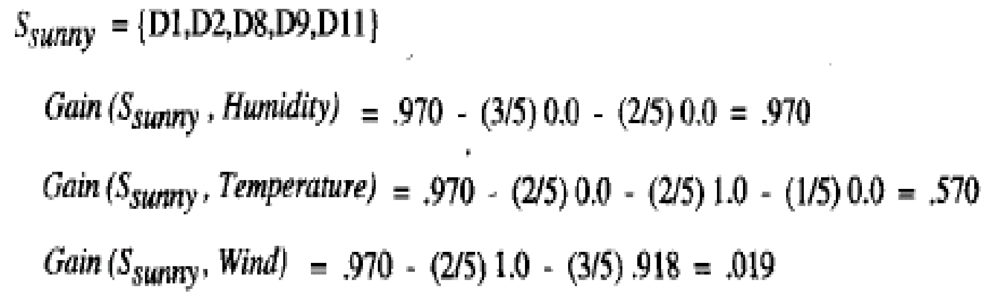
DECISION TREES
‹#›
Notes:
‹#›

Slide 30
DECISION TREES
Example
The process of selecting a new attribute is now repeated for each (non-terminal) descendant node, this time using only training examples associated with that node
Attributes that have been incorporated higher in the tree are excluded, so that any given attribute can appear at most once along any path through the tree
‹#›
Notes:
‹#›

Slide 31
DECISION TREES
Example
This process continues for each new leaf node until either:
Every attribute has already been included along this path through the tree
The training examples associated with a leaf node have zero entropy
‹#›
Notes:
‹#›

Slide 32
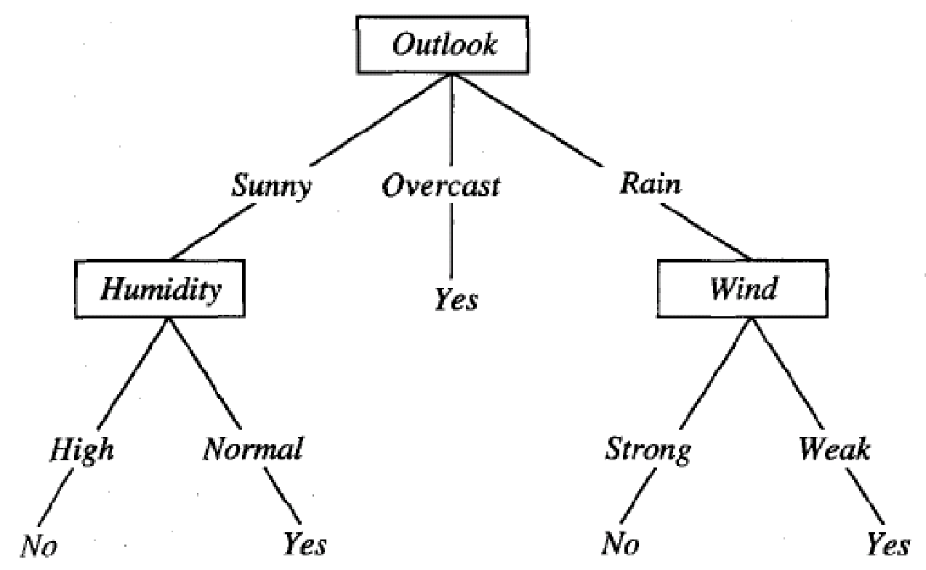
DECISION TREES
Example
‹#›
Notes:
‹#›

Slide 33
DECISION TREES
From Decision Trees to Rules
Next Step: Make rules from the decision tree
After making the identification tree, we trace each path from the root node to leaf node, recording the test outcomes as antecedents and the leaf node classification as the consequent
For our example we have:
If the Outlook is Sunny and the Humidity is High then No
If the Outlook is Sunny and the Humidity is Normal then Yes
...
‹#›
Notes:
‹#›

Slide 34
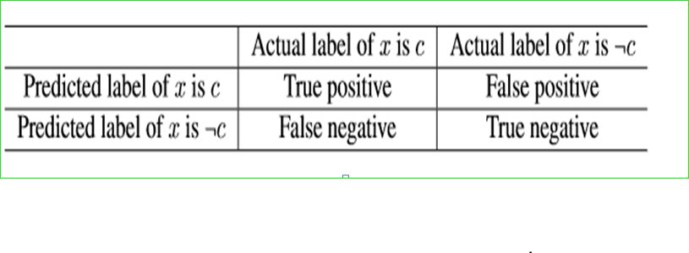
Measuring Error
Consider a Binary Classification Model derived from a two-class dataset.
Let x be a test instance

Slide 35
Measuring Error
True Positive (TP):
Input Output
+ve -> -> +ve
False Positive(FP):
-ve -> -> +ve
False Negative(FN):
+ve -> -> -ve
True Negative(TN):
-ve -> -> -ve
Classifier
Classifier
Classifier
Classifier

Slide 36
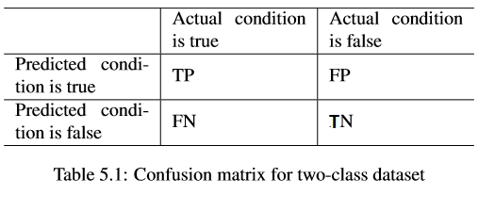
Confusion matrix
A confusion matrix is used to describe the performance of a classification model (or “classifier”) on a set of test data for which the true values are known.
A confusion matrix is a table that categorizes predictions according to whether they match the actual value.

Slide 37
Confusion matrix
If a classiﬁcation system has been trained to distinguish between cats, dogs and rabbits, a confusion matrix will summarize the results of testing the algorithm for further inspection. Assuming a sample of 27animals-8 cats,6 dogs,and13 rabbits
The resulting confusion matrix could look like the table below:

Slide 38
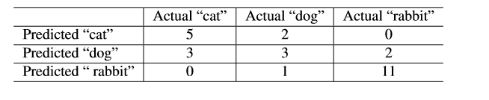

Slide 39
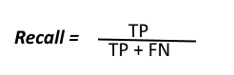
Recall,Precision:
In machine learning, precision and recall are two measures used to assess the quality of results produced by a binary classiﬁer.
Recall:the ratio of the total number of correctly classified positive examples divide to the total number of positive examples.
Recall tells us how many of the actual positive cases we were able to predict correctly with our model.
High Recall indicates the class is correctly recognized

Slide 40
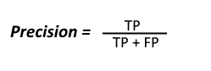
Precision:
Precision:total number of correctly classified positive examples by the total number of predicted positive examples.
Precision tells us how many of the correctly predicted cases actually turned out to be positive.
High recall, low precision: This means that most of the positive examples are correctly recognized (low FN) but there are a lot of false positives.
Low recall, high precision: This shows that we miss a lot of positive examples (high FN) but those we predict as positive are indeed positive (low FP)

Slide 41
Precision & Recall
Precision is a useful metric in cases where False Positive is a higher concern than False Negatives.
Recall is a useful metric in cases where False Negative trumps False Positive.
Recall is important in medical cases where it doesn’t matter whether we raise a false alarm but the actual positive cases should not go undetected!

Slide 42
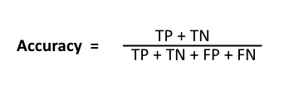
Classification Rate or Accuracy is given by the relation:

Slide 43
SLIQ – Supervised learning in Quest
Scalable classifier
Improving learning time without loss in accuracy.
Tree classifier.
Handles both numerical and categorical data

Slide 44
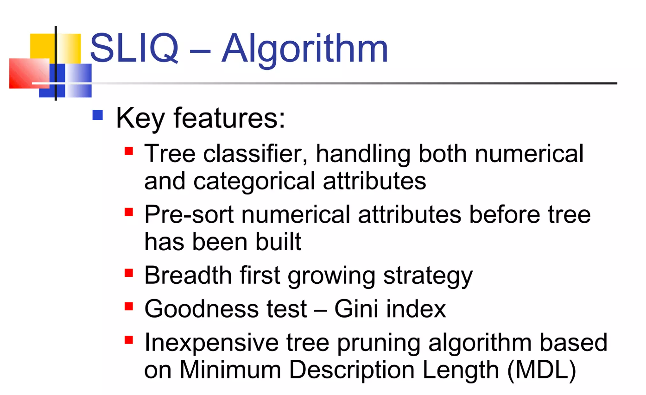

Slide 45
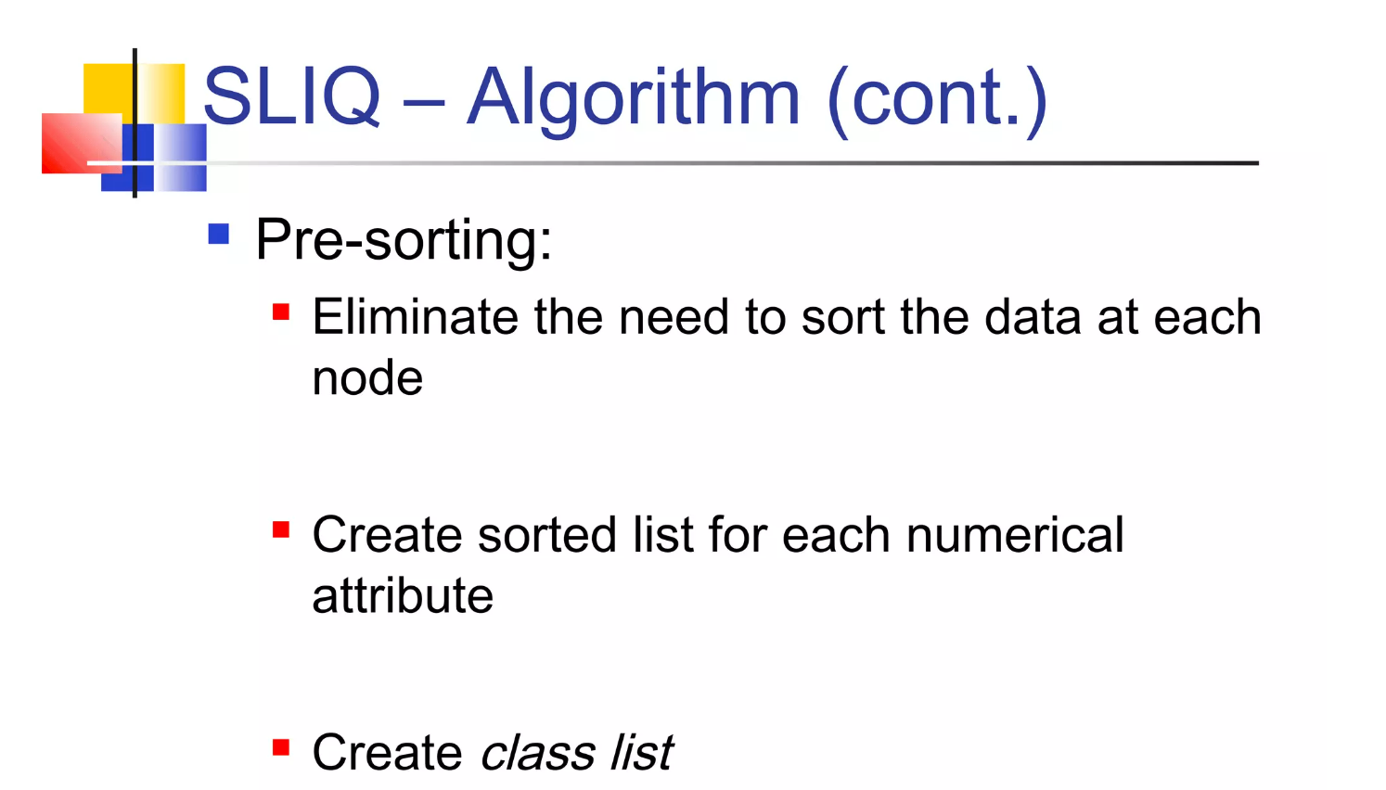

Slide 46
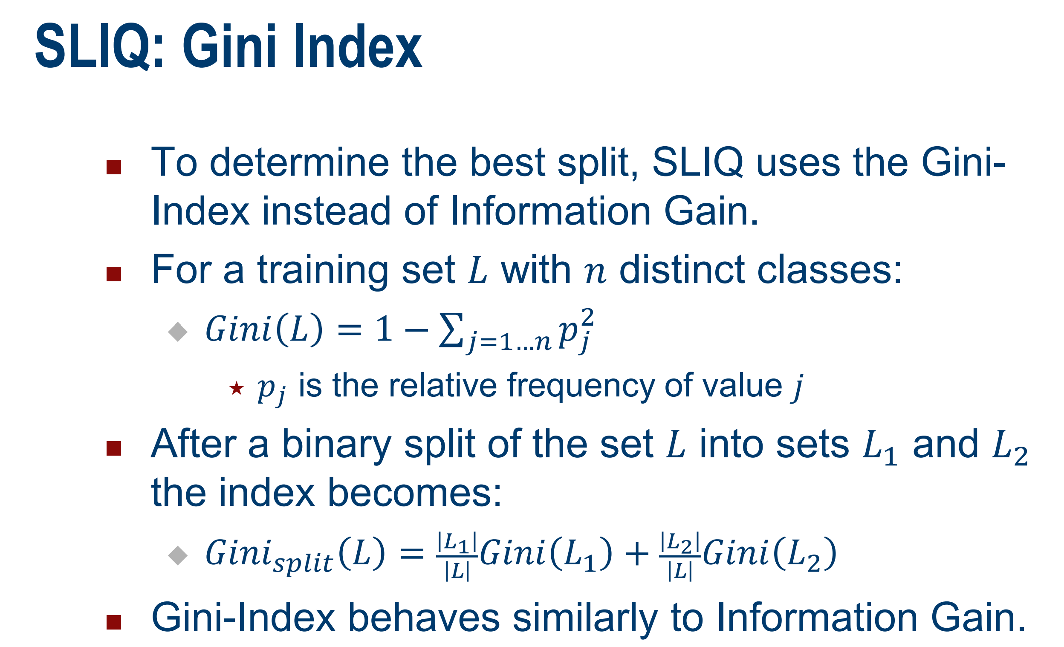

Slide 47
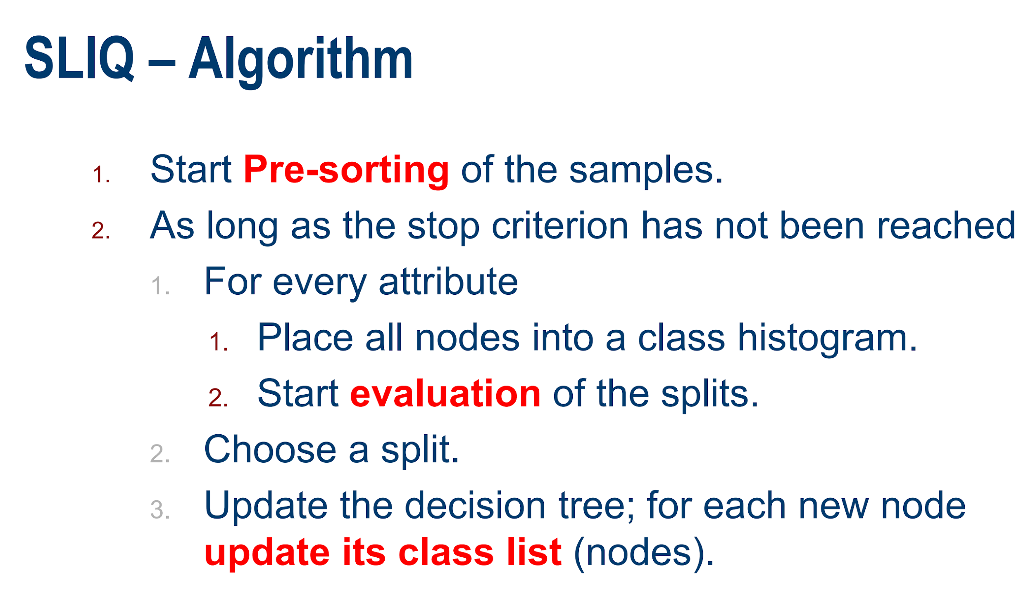

Slide 48
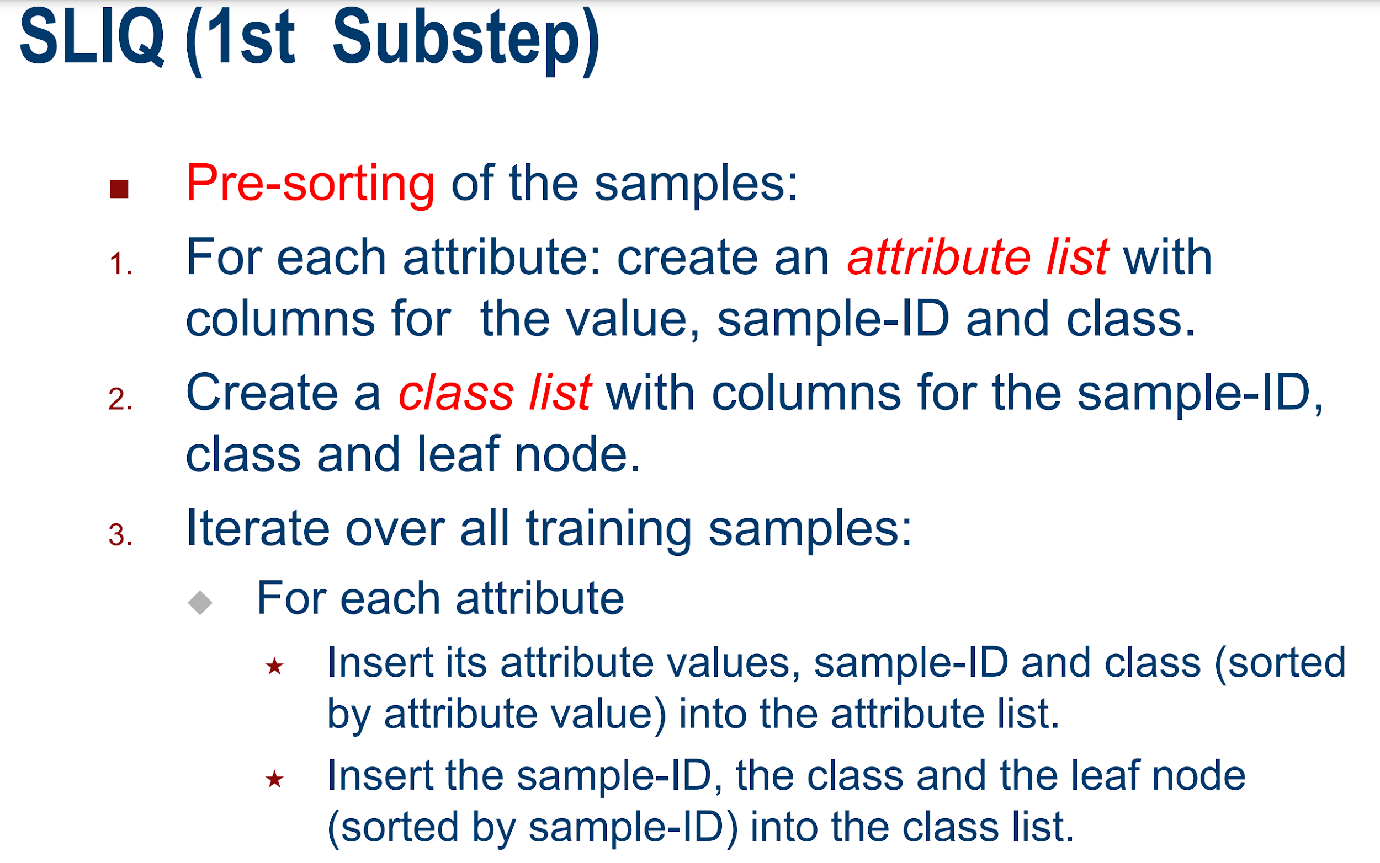

Slide 49
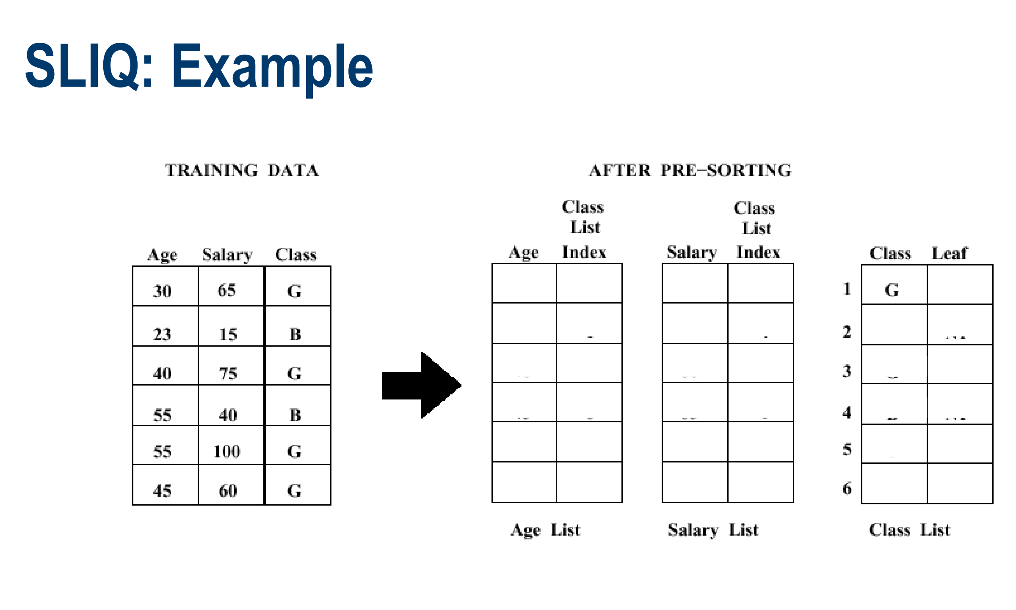

Slide 50
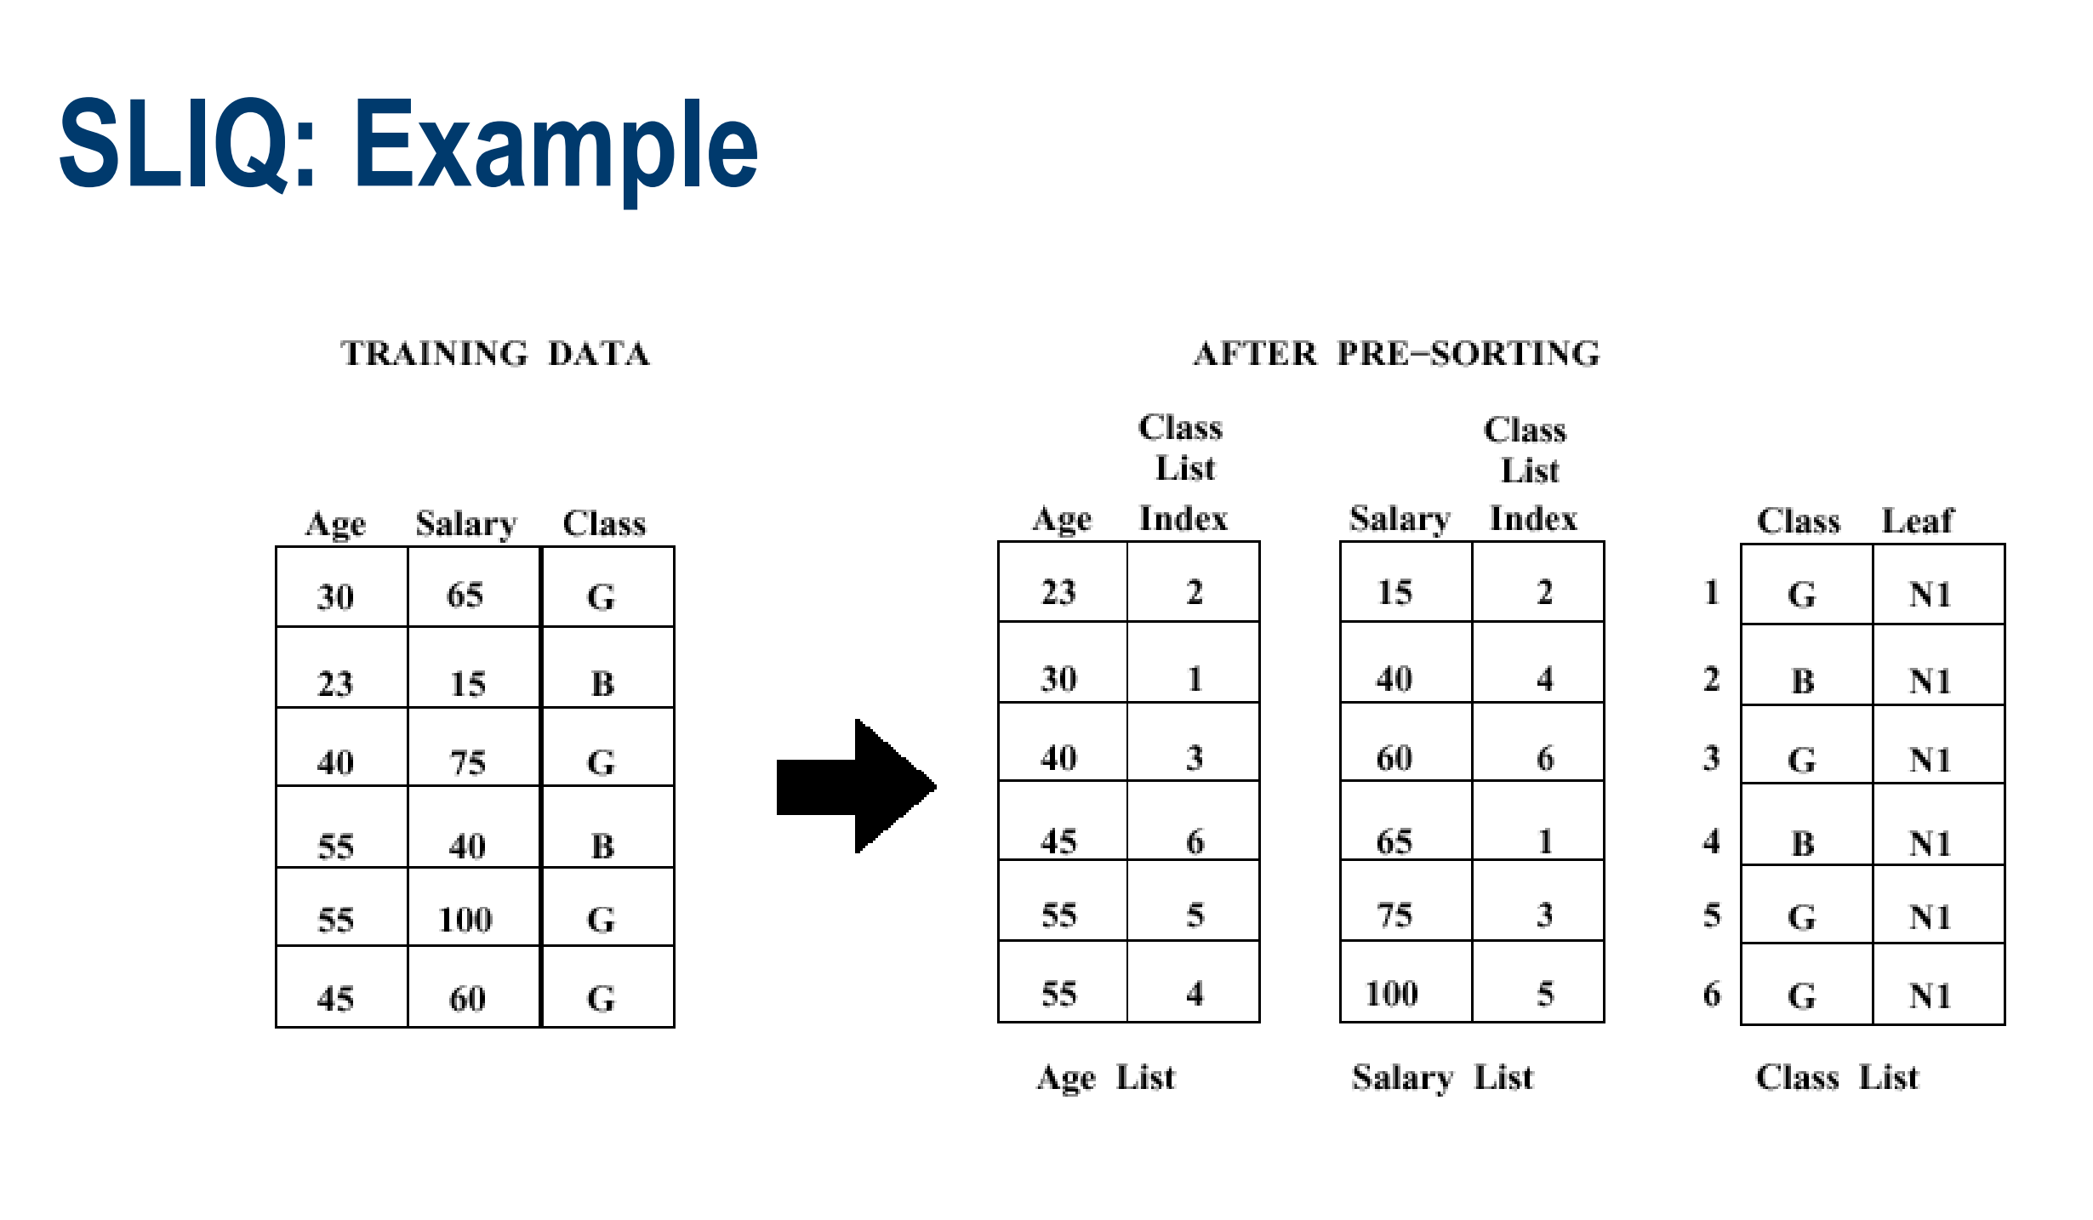

Slide 51
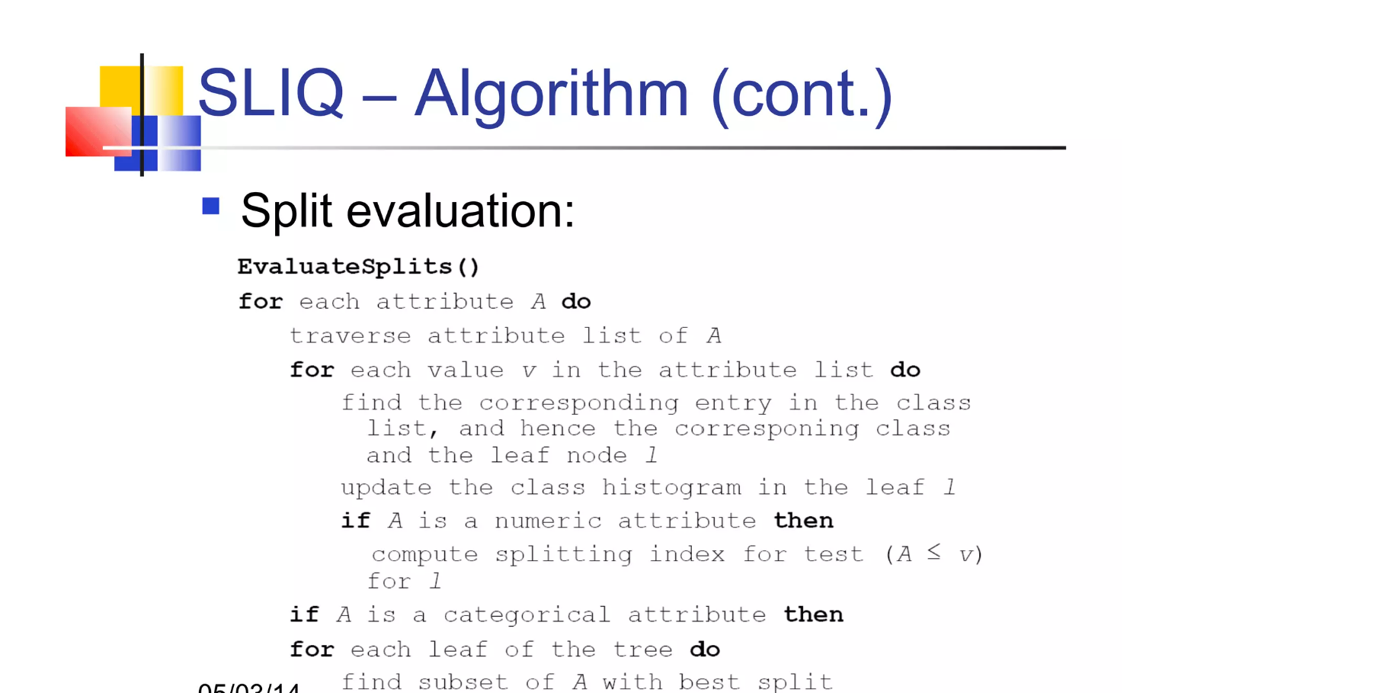

Slide 52
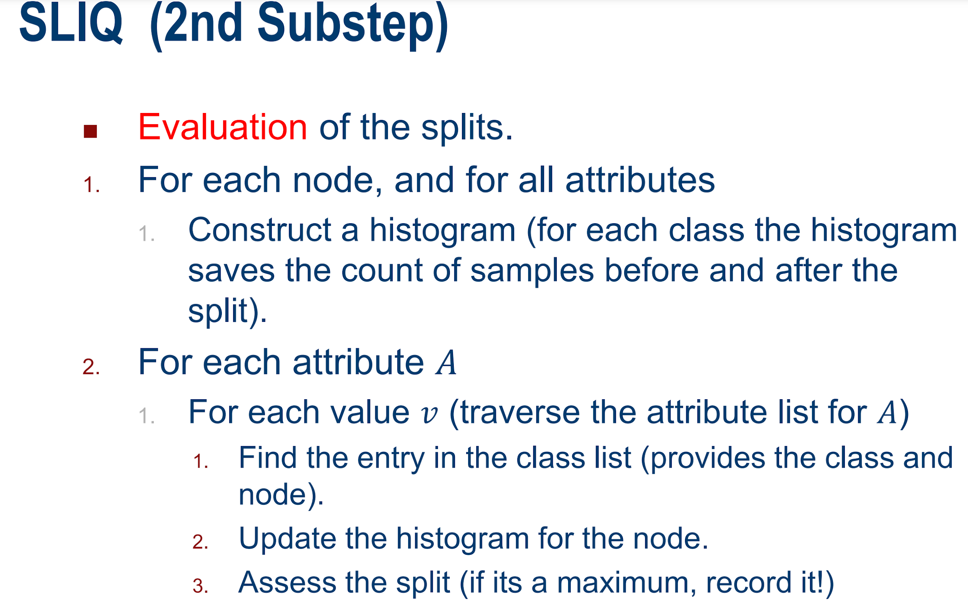

Slide 54
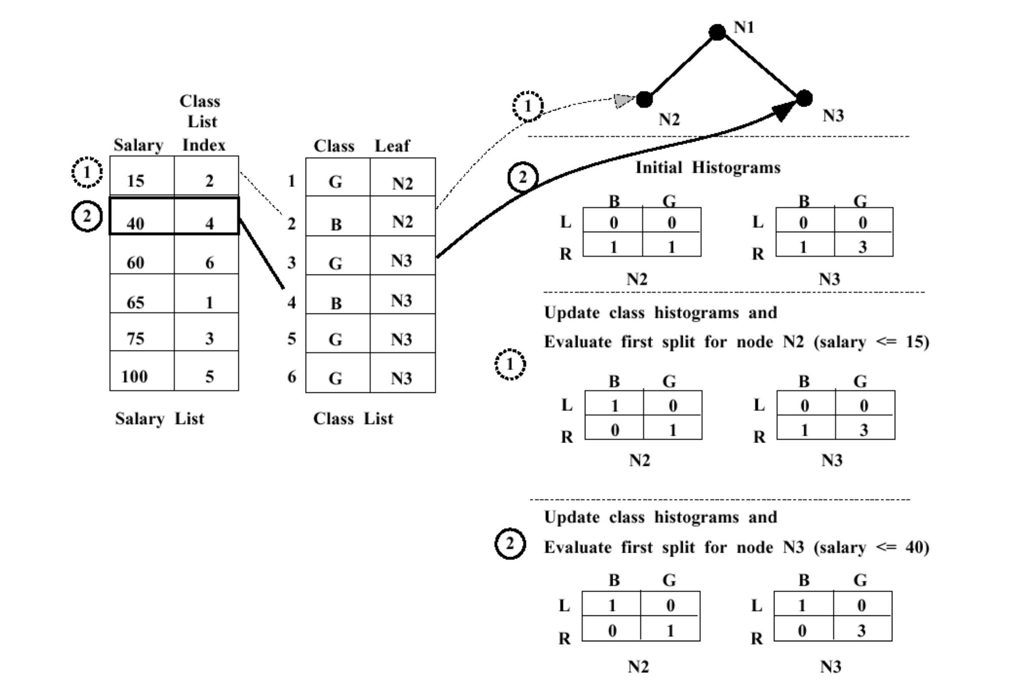

Slide 55
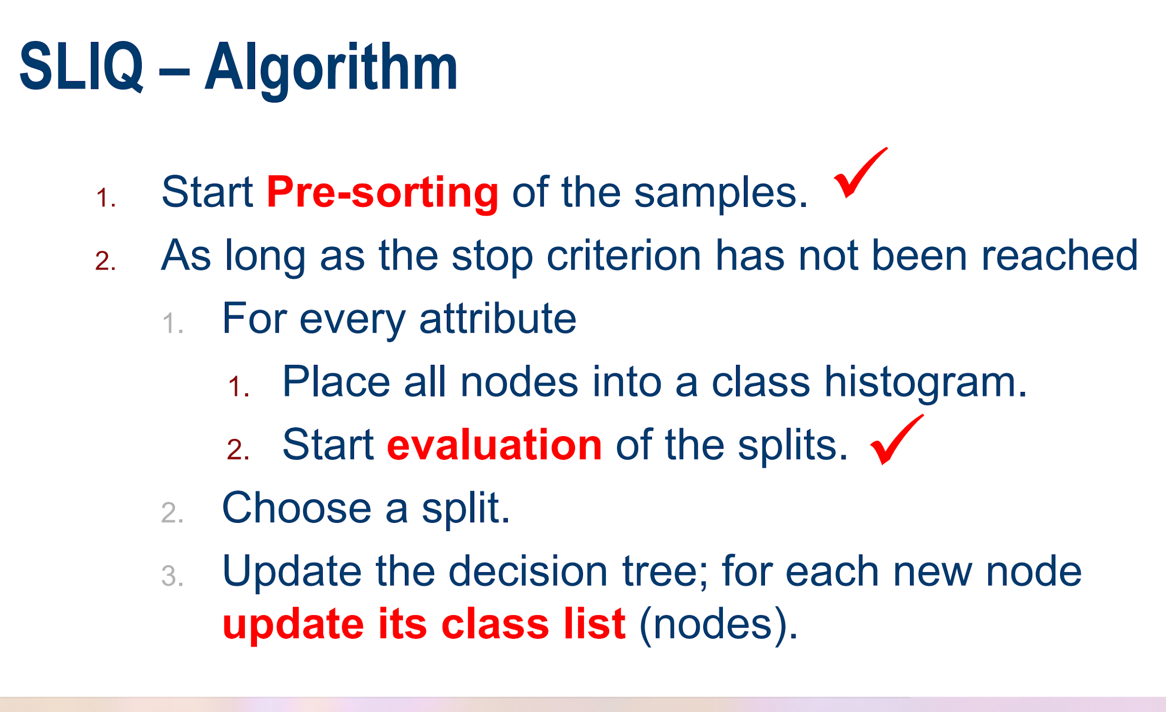

Slide 56
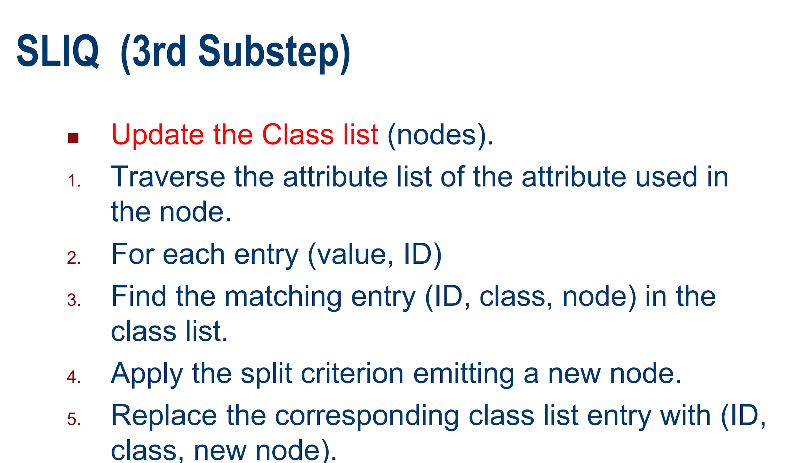

Slide 57
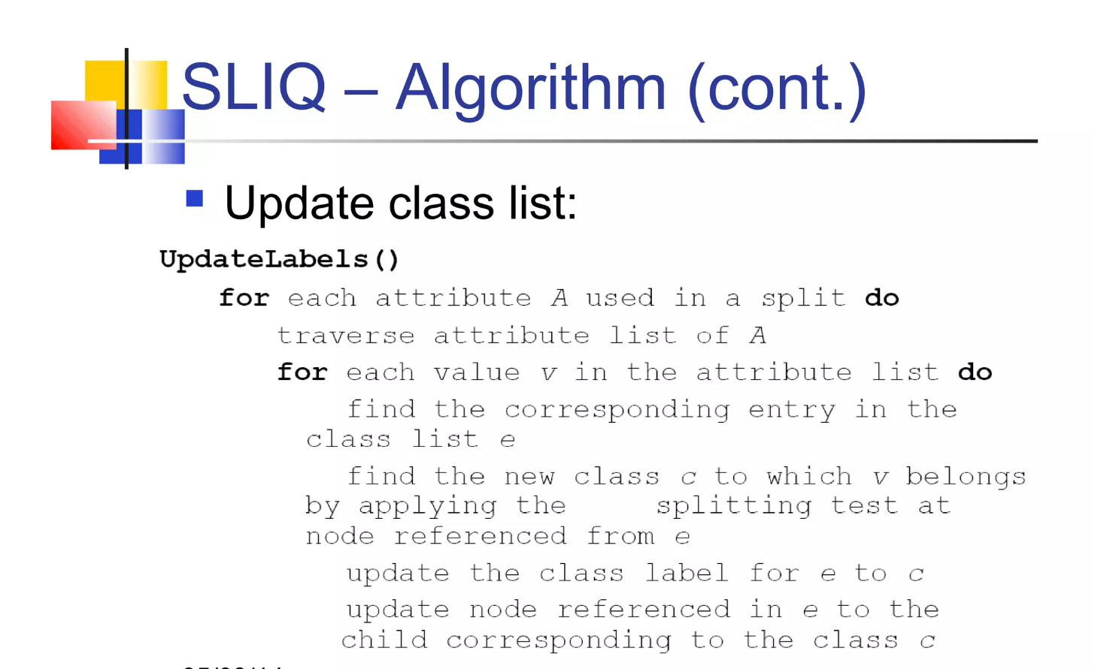

Slide 58
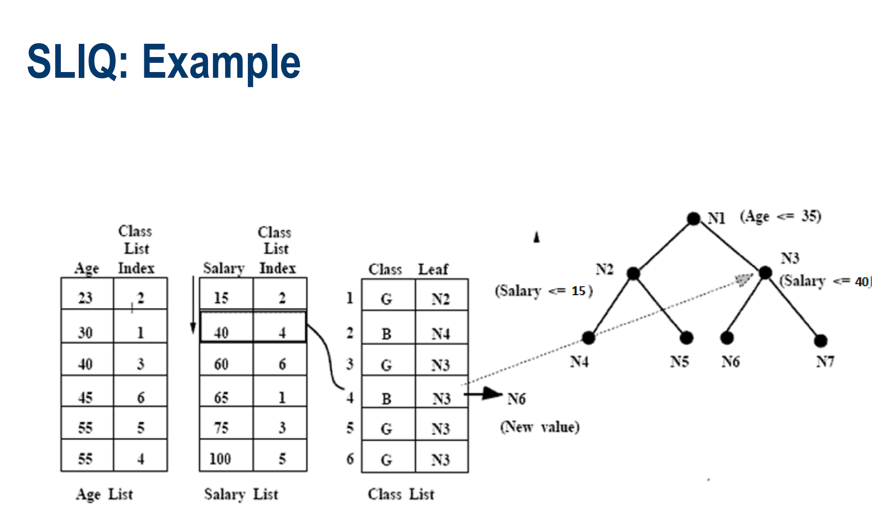

Slide 59


Slide 60


Slide 61


Slide 62


Slide 63

PARTITIONING AROUND MEDOIDS/ K-MEDOID ALGORITHM
‹#›

Slide 64

‹#›

Slide 65

‹#›

Slide 66

‹#›

Slide 67

‹#›

Slide 68

‹#›

Slide 69

‹#›

Slide 70
Hierarchical Clustering
Hierarchical decomposition of DB.
Iterative splitting of DB until some termination condition is satisfied.
Disadvantage: termination condition to be specified.
2 types:
Bottom up (Agglomerative)
Top Down (Divisive)

Slide 71

DBSCAN
Density-based spatial clustering of applications with noise
Clusters can be of arbitrary shape such as those shown in the figure below.
Data may contain noise.

Slide 72
DBSCAN algorithm requires two parameters:
eps : It defines the neighborhood around a data point.
if the distance between two points is lower or equal to ‘eps’ then they are considered neighbors.
If the eps value is chosen too small then large part of the data will be considered as outliers. If it is chosen very large then the clusters will merge and the majority of the data points will be in the same clusters. One way to find the eps value is based on the k-distance graph.
2. MinPts: Minimum number of neighbors (data points) within eps radius.
Larger the dataset, the larger value of MinPts must be chosen.
As a general rule, the minimum MinPts can be derived from the number of dimensions D in the dataset as, MinPts >= D+1. The minimum value of MinPts must be chosen at least 3.

Slide 73

In this algorithm, we have 3 types of data points.
Core Point: A point is a core point if it has more than MinPts points within eps.
Border Point: A point which has fewer than MinPts within eps but it is in the neighborhood of a core point.
Noise or outlier: A point which is not a core point or border point.
Direct Density Reachable: A point p is DDR from point q if q is the core point and P is the neighbor of q.
Density Reachable (DR): Two points are DR, if there is a chain of DDR point that link these two points.

Slide 74


Slide 75
ALGORITHM
Find all the neighbor points within eps and identify the core points or visited with more than MinPts neighbors.
For each core point if it is not already assigned to a cluster, create a new cluster.
Find recursively all its density connected points and assign them to the same cluster as the core point.
A point a and b are said to be density connected if there exist a point c which has a sufficient number of points in its neighbors and both the points a and b are within the eps distance. This is a chaining process. So, if b is neighbor of c, c is neighbor of d, d is neighbor of e, which in turn is neighbor of a implies that b is neighbor
of a.
Iterate through the remaining unvisited points in the dataset. Those points that do not belong to any cluster are noise.

Slide 76


Slide 77
Categorical Clustering Algorithm
ROCK stands for RObust Clustering using linKs.
It is a hierarchical clustering algorithm that analyze the concept of links (the number of common neighbours among two objects) for data with categorical attributes.

Slide 78


Slide 79


Slide 80


Slide 81


Slide 82

ROCK CLUSTERING ALGORITHM

Slide 83


Slide 84


Slide 85


ROCK – RObust Hierarchical Clustering with LinKs

Slide 86



Slide 87

NEIGHBORS AND LINKS

Slide 88


Slide 89



Slide 90

CRITERION FUNCTION
Notes:
‹#›

Slide 91

GOODNESS FUNCTION

Slide 92

ROCK CLUSTERING ALGORITHM

Slide 93


Slide 94

LABEL DATA ON DISK

Slide 95


Slide 96



Slide 97





Slide 98




Slide 99



Slide 100



Slide 101


